Slide 1
An O(n log n)-Time Algorithm for the k-Center Problem in Trees
Haitao Wang, Utah State University
Jingru Zhang, University of Texas Rio Grande Valley
SoCG 2018, Budapest

Slide 2
The k-center problem in a tree
Input: a tree T of n vertices and each vertex $v_{i}$has a weight $w_{i}$ ≥ 0
Goal: find a set Q of k centers on T to minimized the maximum weighted distance from each vertex to its closest center
$\max_{1≤i≤n}{w_{i}d\left(v_{i},Q\right)}$
where $d\left(v_{i},Q\right)=\min_{q∈Q}{d(v_{i},q)}$
A center can be in the
interior of an edge
$$v_{2}$$
$$v_{5}$$
$$v_{10}$$
$$T$$
$$v_{1}$$
$$q_{2}$$
$$q_{1}$$
$$v_{9}$$
$$v_{4}$$
$$v_{7}$$
$$v_{12}$$
$$v_{3}$$
$$v_{6}$$
$$v_{8}$$
$$v_{11}$$
$$Q=\left\{q_{1}, q_{2}\right\}$$
λ*: The optimal objective value

Slide 3
Previous work and our result
O(n² log n), Kariv and Hakimi (1979)
O(nk log n), Jeger and Kariv (1985)
O(n log² n loglog n), Meggido and Tamir (1983)
O(n log² n), Cole’s parametric search (1987)
Open problem:
Is the problem solvable in O(n log n) time?
Banik et al. (2016)
$O\left(n\log{n}+k{(\log{n})}^{2}\log{{(n}/k)}\right)$
Our result: $O(n\log{n})$ time

Slide 4
The decision problem
λ*: The optimal objective value
Given a value $λ$, determine whether λ ≥ λ*
if yes, λ is a feasible value
O(n) time, Kariv and Hakimi (1979)

Slide 5
Previous techniques
Form sorted matrices on candidate values for λ*
Apply the sorted matrix searching technique by using the O(n)-time decision algorithm, Frederickson and Johnson (1984)
Parametric search, Cole (1987)
The difficulty: The weights on the vertices
If no weights, O(n) time, Frederickson (1991)
Three schemes:
O(n (loglog n)²) time
O(n log* n) time
O(n) time

Slide 6
Our techniques
Sorted matrices searching
2D sublist linear programming queries
Reducing the problem to searching vertices in a line arrangement
Three phases:
Phase 0: Reducing the number of leaves to $\frac{2n}{{(log{n})}^{2}}$
Phase 1: Computing data structures to solve the decision problem in sub-linear time, $O(\frac{n}{{(log{n})}^{2}}{\left(\log{\log{n}}\right)}^{3})$
Phase 2: Solve the problem using the sub-linear decision algorithm

Slide 7
An O(n)-time decision algorithm
Given λ, determine whether λ ≥ λ*?
Find a set Q of a minimum number of centers on T such that
$$\max_{1≤i≤n}{w_{i}d(v_{i},Q)≤λ }$$
$|Q |≤k$ ?
Yes
No
$$λ≥λ^{∗}$$
$$λ<λ^{∗}$$

Slide 8
An O(n)-time decision algorithm
Place centers on $T$ from bottom to top in a greedy manner: place centers as high as possible
$$v_{15}$$
$$v_{8}$$
$$v_{14}$$
$$v_{3}$$
$$v_{7}$$
$$v_{13}$$
$$q_{1}$$
$$v_{9}$$
$$v_{4}$$
$$v_{1}$$
$$v_{2}$$
$$v_{5}$$
$$v_{6}$$
$$v_{10}$$
$$v_{11}$$
$$v_{12}$$

Slide 9
Phase 0: Reducing the number of leaves to 2n/r, with r = log²n
A path partition: Partition the edges of T into paths where a vertex v is an endpoint of a path if the degree of v is not 2
v
A leaf path: a path with a leaf as an endpoint

Slide 10
Phase 0
S: the set of all leaf paths of lengths at most r
Form sorted matrices on S
Consisting of all candidate values for λ* on the paths of S

Slide 11
A matrix element
$$v_{6}$$
A matrix element: Given i and j, the
optimal objective value for using
one center to cover all vertices v_{i},v_{i+1},…,v_{j}
$$v_{5}$$
$$v_{4}$$
$$v_{3}$$
$$v_{2}$$
$$v_{1}$$

Slide 12
Phase 0
S: the set of all leaf paths of lengths at most r
Form sorted matrices on S
Run matrix searching algorithm to obtain a range (λ₁,λ₂)
λ₁ < λ* ≤ λ₂
Only need to consider feasible values in (λ₁,λ₂) in future
Some leaf paths of S become “inactive”: their matrices do not contain any value in (λ₁,λ₂)
Process the inactive paths: placing centers there by running the decision algorithm using any value λ in (λ₁,λ₂)
Observation: If λ* is in (λ₁,λ₂), then the decision algorithm would behave combinatorially the same with λ = λ*

Slide 13
Processing an inactive leaf path
Run the decision algorithm in a bottom-up manner
$$v_{6}$$
Remove the last center, but keep a dominating vertex v with an edge connecting v₆, such that if a center in the path that can cover v also covers all other vertices (v₄ and v₅)
$$v_{5}$$
The path is replaced by a twig which is an (artificial) edge from the top vertex to the dominating vertex v
$$v_{4}$$
$$v_{4}$$
$$v_{3}$$
We will need to place a center on the twig in the future algorithm
$$v_{2}$$
$$v_{1}$$

Slide 14
Processing an inactive leaf path (the second case): the last center is outside the path
Remove the last center, but keep a dominating vertex v with an edge connecting v₆, such that if a center outside the path that can cover v also covers all other vertices (v₄ and v₅)
$$v_{6}$$
The path is replaced by a thorn which is an (artificial) edge from the top vertex to the dominating vertex
$$v_{5}$$
$$v_{4}$$
$$v_{4}$$
The difference between a twig and a thorn:
In the future algorithm, a center will be placed
at a twig while this may not be true for a thorn
$$v_{3}$$
$$v_{2}$$
$$v_{1}$$

Slide 15
Phase 0
After processing all inactive leaf paths, if the number of leaves at the new tree is still more than 2n/r
Run the same algorithm again but need to take care of the twigs and thorns
Compute a path partition of the new tree without twigs and thorns
Each path, along with all attached twigs and thorn, is called a stem
A stem-partition of the tree
A leaf-stem: if the path has a leaf

Slide 16
A stem
$$v_{6}$$
a thorn
$$v_{5}$$
a twig
$$v_{4}$$
$$v_{3}$$
$$v_{2}$$
$$v_{1}$$

Slide 17
Phase 0
S: the set of all leaf stems of lengths at most r
Form matrices on S
Need to consider all thorns and twigs

Slide 18
A matrix element
Given i and j, a matrix element is the optimal objective value of one of the following one center problems:
All path vertices and thorn vertices from v_{i} to v_{j}
The twig vertex at v_{i}, in addition to all path vertices and thorn vertices from v_{i} to v_{j}
$$v_{j}$$
$$v_{i}$$
thorns
twigs

Slide 19
Phase 0
S: the set of all leaf stems of lengths at most r
Form matrices on S
Need to consider all thorns and twigs
Run matrix searching algorithm to update (shrink) the range (λ₁,λ₂)
Some leaf stems of S become “inactive”
Process the inactive stems: Replace each of them by a thorn or twig
Run the algorithm recursively until the new tree has at most 2n/r leaves

Slide 20
Phase 1: a sub-linear decision algorithm
Perform a stem partition
Partition stems into substems of size r

Slide 21
Phase 1: an sublinear decision algorithm
Build a stem tree: each substem defines a vertex and the edges follow their adjacent positions in the original tree
stem tree
original tree (excluding twigs and thorns)

Slide 22
Phase 1: Building a data structure on substems
Based on the top center at the lower stem, we can determine the top center at the upper stem in sub-linear time
The data structure provides an interface between two adjacent stems
Twigs and thorns
A sub-linear decision algorithm
$O(\frac{n}{{(log{n})}^{2}}{\left(\log{\log{n}}\right)}^{3})$ time

Slide 23
Phase 2: Compute $λ^{∗}$ using the sub-linear decision algorithm
T is a single stem?
Yes
No
Compute λ* on the single stem
Do a stem-partition
Search the stems by using sub-linear decision algorithm and shrink $(λ_{1}, λ_{2})$
Processing each inactive leaf stem: replace it by a thorn or a twig

Slide 24
The discrete case
Centers are required to be at vertices of T
Previous work
O(n log² n) time (Megiddo, Tamir, Zemel, Chandrasekaran, 1981)
Our result: O(n log n) time
Similar techniques

Slide 25
Thank you for your attention!

Slide 26
Computing a matrix element
A matrix element: Given i and j, the optimal objective value for
using one center to cover all vertices v_{i},v_{i+1},…,v_{j}
$$v_{6}$$
w₂
-w₂
$$v_{5}$$
$$v_{1}$$
$$v_{2}$$
$$v_{3}$$
$$v_{4}$$
$$v_{5}$$
$$v_{6}$$
x
$$v_{4}$$
Define two upper half-planes for each vertex v_{i}, whose bounding lines have slopes w_{i} and –w_{i}, respectively
$$v_{3}$$
The optimal objective value corresponds to the lowest point
in the common intersection of the half-planes from v_{i} to v_{j}
The 2D sublist LP queries:
Given m half-planes $H=\{h_{1},h_{2},, . . . ,h_{m}\}$and two indices i and j, a 2D sublist LP query asks for the lowest point in the common intersection of half-planes $h_{i},h_{i+1},, . . . ,h_{i}$
$$v_{2}$$
$$v_{1}$$
Preprocessing: O(n log n) time; query: (log² n) time

Slide 27
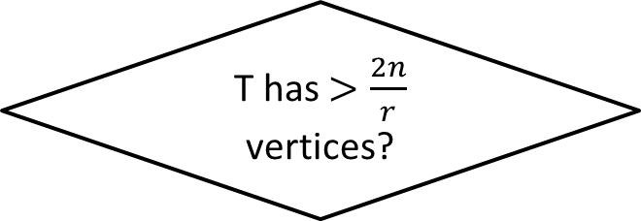
Phase 0: a summary
T has $>\frac{2n}{r}$ vertices?
Phase 1
No
Yes
Do a stem-partition; form matrices
Search matrices and shrink $(λ_{1}, λ_{2})$
Process inactive leaf-stems: Replace each of them by a thorn or a twig
Eliminate redundant twigs and thorns such that every vertex has at most one twig and at most one thorn

Slide 28

Observations
Under $λ^{∗}$
Vertices covered by each center leads a connected subtree of T.
$$v_{15}$$
$$w_{2}{d(v}_{2},q)=w_{8}d\left(v_{8},q\right)=λ^{∗}$$
$$v_{8}$$
$$v_{14}$$
$$v_{3}$$
$$v_{7}$$
$$v_{13}$$
$$v_{9}$$
$$v_{4}$$
$$v_{1}$$
$$v_{2}$$
$$v_{5}$$
$$v_{6}$$
$$v_{10}$$
$$v_{11}$$
$$v_{12}$$

Slide 29
Phase 0: Place centers under $λ^{∗}$
Observation: under $λ^{∗}$, this path are divided into connected subtrees.
For every connected subtrees, consider the one-center problem and one $λ$ could be $λ^{∗}$.
Observations:
Solve the one-center on every connected subtree and each give us a $λ$ value
For every $λ$, do a feasibility test by the decision algorithm and get a range $(λ_{1},λ_{2}]$ which contains $λ^{∗}$ but no other $λ$ values
$$v_{1}$$
For any $λ∈(λ_{1},λ_{2}]$, the decision algorithm will partition this paths into same subtrees.

Slide 30
Phase 0: Replacing a leaf-path
Replace a leaf-path by a thorn or a twig
Stem: paths where each vertex is allowed to have twigs or thorns but no backbone (normal vertex).
A leaf Stem

Slide 31
Phase 0: Replacing leaf-stems
$$v_{6}$$
$$v_{5}$$
$$u_{5}$$
$$v_{1}$$
$$v_{2}$$
$$v_{3}$$
$$v_{4}$$
$$v_{5}$$
$$w_{5}$$
$$w_{5}$$
$$v_{4}$$
$$u_{4}$$
$$u_{3}$$
$$u_{4}$$
$$u_{5}$$
$$u_{3}$$
$$v_{3}$$
The center covering $π(v_{3},v_{5})$ is determined by $w_{5}$ and a backbone or a thorn below $v_{5}$.
$$w_{2}$$
$$v_{2}$$
The 2D sublist LP queries: The optimal $λ$ is the y-coordinate of the lowest common intersections of half-planes.
$$v_{1}$$

Slide 32
Phase 1: a sub-linear decision algorithm
Perform a stem partition
Partition stems into substems of size r

Slide 33
Phase 1: an $O(\frac{n}{r{\left(\log{r}\right)}^{3}})$ decision algorithm
$O\left(n\log{n}\right)$ Preprocessing work:
Compute half-planes as described in phase 0
Test $λ$ values of sub-stems until $O({(log{n})}^{2})$ remains
Build data structures for sub-stems whose all $λ$ values have been tested.
With those data structures, the feasibility test of any value can be done in on this stem tree in $O(\frac{n}{r{\left(\log{r}\right)}^{3}})$ time.

Slide 34
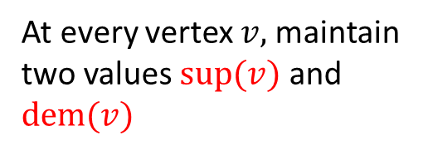
An O(n)-time decision algorithm
Place centers on $T$ from bottom to top in a greedy manner
$$v_{15}$$
If $w_{1}d\left(v_{1},v_{3}\right)≥λ$, place a center at $q_{1}$on edge (v₁,v₃)
Otherwise, do not place a center
$$v_{8}$$
$$v_{14}$$
At every vertex $v,$ maintain two values $sup⁡(v)$ and $dem⁡(v)$
$$v_{3}$$
$$v_{7}$$
$$v_{13}$$
$$q_{1}$$
$$v_{9}$$
$$v_{4}$$
$$v_{1}$$
$$v_{2}$$
$$v_{5}$$
$$v_{6}$$
$$v_{10}$$
$$v_{11}$$
$$v_{12}$$
$w_{1}d\left(q_{1},v_{1}\right)=λ$ --- $q_{1}$ is the furthest center covering $v_{1}$

Slide 35
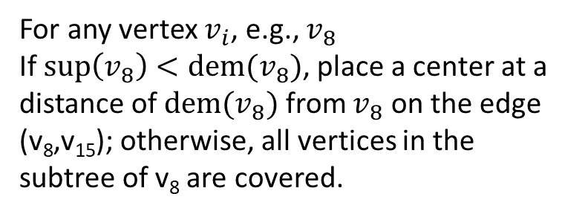
An O(n)-time decision algorithm
For any vertex $v_{i}$, e.g., $v_{8}$
If $\sup\left(v_{8}\right)<dem⁡(v_{8})$, place a center at a distance of $dem⁡(v_{8})$ from $v_{8}$ on the edge (v₈,v₁₅); otherwise, all vertices in the subtree of v₈ are covered.
$$v_{15}$$
$$q$$
$$T(v_{8})$$
$$v_{8}$$
$$v_{14}$$
$$v_{3}$$
$$v_{7}$$
$$v_{13}$$
$$v_{9}$$
$$v_{4}$$
$$v_{1}$$
$$v_{2}$$
$$v_{5}$$
$$v_{6}$$
$$v_{10}$$
$$v_{11}$$
$$v_{12}$$
Note $q$ is the furthest center covering all vertices in the subtree of$v_{8}$

